Slide 1
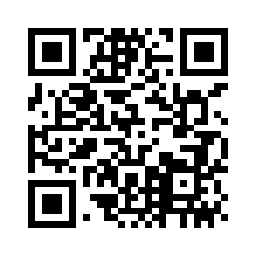
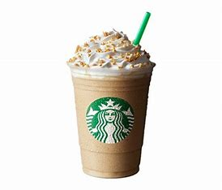
Special Events & Promotions
Easter
Fried Fish Day
Dr. Seuss’ Birthday
Add a cookie to your order!
Pound Cake Day,
Both Cafs @Lunch
Go Rams!
Fried Chicken Day
Cereal Day
Intl Women’s Day
Meatball Day
Get some in both Cafs/Dinner
Spring Break
Harriet Tubman Birthday
Hershey Stuffed Breakfast Pancakes in both Cafs.
Tonight in both Cafs
Fried Chicken Day
Pi Day = Pie Day
Grab a slice at lunch and dinner in the Cafs.
Fried Fish Day
Pre-St. Patrick’s Day Brunch/East Caf
St. Patrick’s Day
Sloppy Joe Day at lunch in both Cafs.
Let the games begin.
Ravioli Day in both Cafs at dinner.
BeWell Tasting, Lunch,
East Caf
Dine With The Director,
4 PM, East Caf
Fried Fish Day
So Good!
Mushrooms
Cheesesteak Day at brunch in both Cafs
Oreo Crunch Bon Bon at lunch in both Cafs.
Fried Chicken Day
Tonight in both Cafs
Fried Fish Day
Use the mobile ordering app for easy pickup!
Aladdin Campus Dining
Notes:
The featured monthly special events and food days have been populated into the template. The picture and text can be removed if not featuring. These can be featured on the day of your choosing. Approved images can be found on SharePoint.
Insert Picture: To insert picture, click on the picture icon and select the corresponding image from the approved images provided.
Any other events, specials or promotions can be added to the calendar.
If no picture is inserted, nothing will show up when printed.

